Slide 1
JAVA FS : ECE & EIE 3rd Year
DAY 15
Hierarchical Inheritance

Slide 2
Internal Details of Hello Java Program
What happens at compile time?
At compile time, java file is compiled by Java Compiler (It does not interact with OS) and converts the java code into bytecode.

Slide 3
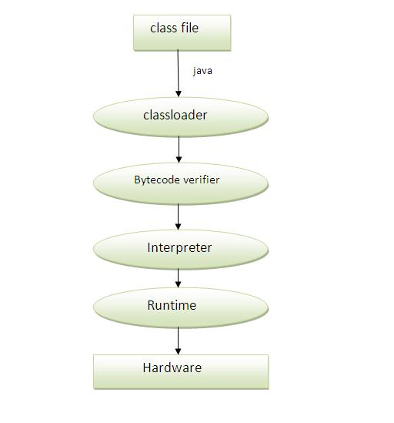
What happens at runtime?
At runtime, following steps are performed:
Classloader: is the subsystem of JVM that is used to load class files.
Bytecode Verifier: checks the code fragments for illegal code that can violate access right to objects.
Interpreter: read bytecode stream then execute the instructions.

Slide 4
Basic differences between the JDK,JRE and JVM
JRE is an acronym for Java Runtime Environment.
It is used to provide runtime environment.
The Java Runtime Environment (JRE) is a set of software tools for development of Java applications.
It combines the Java Virtual Machine (JVM),
platform core classes and
supporting libraries.
JRE is the implementation of JVM.
It physically exists.
It contains set of libraries + other files that JVM uses at runtime.

Slide 5
JVM (Java Virtual Machine)
Internal Architecture of JVM
JVM (Java Virtual Machine) is an abstract machine. It is a specification that provides runtime environment in which java bytecode can be executed.
JVMs are available for many hardware and software platforms (i.e. JVM is platform dependent).
What is JVM
It is:
A specification where working of Java Virtual Machine is specified. But implementation provider is independent to choose the algorithm. Its implementation has been provided by Sun and other companies.
An implementation Its implementation is known as JRE (Java Runtime Environment).
Runtime Instance Whenever you write java command on the command prompt to run the java class, an instance of JVM is created.

Slide 6
JVM (Java Virtual Machine)
What it does
The JVM performs following operation:
Loads code
Verifies code
Executes code
Provides runtime environment
JVM provides definitions for the:
Memory area
Class file format
Register set
Garbage-collected heap
Fatal error reporting etc.

Slide 7
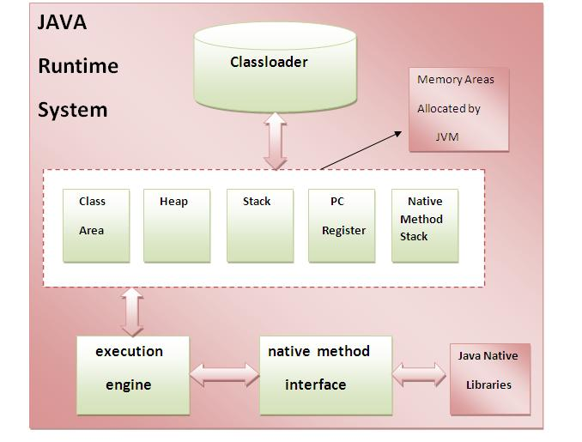
Internal Architecture of JVM
Classloader is a subsystem of JVM that is used to load class files.
Class(Method) Area stores per-class structures such as the runtime constant pool, field and method data, the code for methods.
Native Method Stack
It contains all the native methods used in the application.
Heap: It is the runtime data area in which objects are allocated.
PC (program counter) register. It contains the address of the Java virtual machine instruction currently being executed.
Java Stack stores frames.It holds local variables and partial results, and plays a part in method invocation and return.Each thread has a private JVM stack, created at the same time as thread.A new frame is created each time a method is invoked. A frame is destroyed when its method invocation completes.
Execution Engine contains:
A virtual processor
Interpreter: Read bytecode stream then execute the instructions.
Just-In-Time(JIT) compiler:

Slide 8
JDK (Java Development Kit)
Java Development Kit (JDK) is a bundle of software components that is used to develop Java based applications.
It includes :
The Java Runtime Environment (JRE),
An interpreter/loader (java),
A compiler (javac),
Java ARchiver (jar),
A documentation generator (javadoc) and
Other tools needed in Java development.

Slide 9
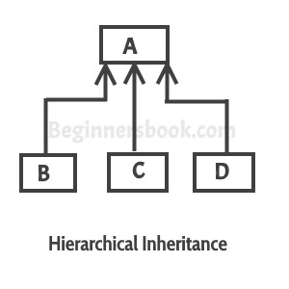
Inheritance (IS-A) vs. Composition (HAS-A) Relationship
When a class has more than one child classes (sub classes) or
in other words more than one child classes have the same parent class then this type of inheritance is known as hierarchical inheritance.

Slide 10
Hierarchical Inheritance (IS-A)
class FsL8HigherArchical
{
public static void main(String args[])
{
B obj1 = new B();
C obj2 = new C();
//All classes can access
//the method of class A
obj1.methodA();
obj2.methodA();
}
}
class A
{
public void methodA()
{ System.out.println("method of Class A"); }
}
class B extends A
{
public void methodB()
{ System.out.println("method of Class B"); }
}
class C extends A
{
public void methodC()
{ System.out.println("method of Class C"); }
}

Slide 11
Exercise
/*
WAJP create class containing main which should display:
Enter Rows for A & B pyramids:
On entering the values say : 3 4
The main function should pass these parameters (say 3) to
parameterized constructor of class "A" and parameters (say 4) to
parameterized constructor of class "B"
Class A & B are created using Hier-archical inheritance from another
class BaseClass. This base class should have a function called
pyramid wich takes one parameter of int data type and has the logic
to display the pyramid of *
Enter Rows for A & B pyramids: 3 4
*
* *
* * *
*
* *
* * *
* * * *
*/ 9440498794 anant krishnan hyd uni prasad banarase vidyanidhi

Slide 12
Exercise
import java.util.Scanner;
class BaseClass
{
int k,n=0;
public void pyramid(int n)
{
k = 2*n - 2;
// outer loop to handle number of rows
// n in this case
for (int i=0; i<n; i++)
{
// inner loop to handle number spaces
// values changing acc. to requirement
for (int j=0; j<k; j++)
{
// printing spaces
System.out.print(" ");
}
// decrementing k after each loop
k = k - 1;
// inner loop to handle number of columns
// values changing acc. to outer loop
for (int j=0; j<=i; j++ )
{
// printing stars
System.out.print("* ");
}
// ending line after each row
System.out.println();
}
}
}
class A extends BaseClass
{
A(int n)
{pyramid(n); }
}
class B extends BaseClass
{
B(int n)
{ pyramid(n); }
}
class FsL9HierArchicalEx1
{
static int aN, bN;
public static void main(String args[])
{
System.out.print("Enter Rows for A & B
pyramids: ");
Scanner s = new Scanner(System.in);
aN = s.nextInt();
bN = s.nextInt();
A objA = new A(aN);
B objB = new B(bN);
}
}

Slide 13
Inheritance (IS-A) vs. Composition (HAS-A) Relationship
In object-oriented programming, the concept of IS-A is a totally based on Inheritance, which can be of two types Class Inheritance or Interface Inheritance.
It is just like saying “A is a B type ". For example, Apple is a Fruit, Car is a Vehicle etc. Inheritance is uni-directional. For example, House is a Building. But Building is not a House.
IS-A relationship is identified when an extends keyword is used in a class declaration.
HAS-A Relationship:
Composition(HAS-A) simply mean the use of instance variables that are references to other objects. For example Maruti HAS A Suspension System, or House HAS A Lift.

Slide 14
//Example of Is A and Has A
class Car //Parent Class
{
private String color; //Instance members
private int maxSpeed;
public void carInfo() // Methods implementation
{
System.out.println("Car Color= "+color + " Max Speed= " + maxSpeed);
}
public void setColor(String color)
{this.color = color;}
public void setMaxSpeed(int maxSpeed)
{this.maxSpeed = maxSpeed;}
}

Slide 15
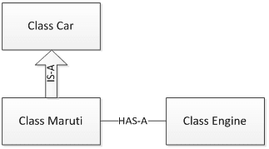
Example
class Maruti extends Car //Sub Class
{
public void MarutiStartDemo()
{
Engine MarutiEngine = new Engine();
//Has A relationship
MarutiEngine.start();
}
}
public class FsM1HasA
{
public static void main(String args[])
{
Maruti m = new Maruti();
m.MarutiStartDemo();
m.setColor("Red");
m.setMaxSpeed(120);
m.carInfo();
}
}
HAS A
class Engine
{
public void start()
{ System.out.println("Engine Started:"); }
public void stop()
{ System.out.print("Engine Stopped:"); }
}

Slide 16
Hierarchical inheritance in Java
Comparing Composition and Inheritance
It is easier to change the class implementing composition than inheritance. The change of a superclass impacts the inheritance hierarchy to subclasses.
You can't add to a subclass a method with the same signature but a different return type as a method inherited from a superclass. Composition, on the other hand, allows you to change the interface of a front-end class without affecting back-end classes.
Composition is dynamic binding (run-time binding) while Inheritance is static binding (compile time binding)
It is easier to add new subclasses (inheritance) than it is to add new front-end classes (composition) because inheritance comes with polymorphism. If you have a bit of code that relies only on a superclass interface, that code can work with a new subclass without change. This is not true of composition unless you use composition with interfaces. Used together, composition and interfaces make a very powerful design tool.
With both composition and inheritance, changing the implementation (not the interface) of any class is easy. The ripple effect of implementation changes remains inside the same class.
Don't use inheritance just to get code reuse If all you really want is to reuse code and there is no is-a relationship in sight, use composition.
Don't use inheritance just to get at polymorphism If all you really want is a polymorphism, but there is no natural is-a relationship, use composition with interfaces.

Slide 17
Access Specifier / Modifier
public class FsL4Inheritance extends Clock
{
public static void main(String args[])
{
FsL4Inheritance obj = new FsL4Inheritance();
obj.timing();
}
public void timing()
{
System.out.print("enter time");
Scanner s = new Scanner(System.in);
long time = s.nextLong();
//time = s.nextLong(); //error: time has private access in Clock
setTime(time);
System.out.print("time is :"+getTime());
}
}
import java.util.Scanner;
class Clock
{
private long time = 0;
public long getTime()
{ return this.time; }
public void setTime(long theTime)
{ this.time = theTime; }
}
timing();//error: non-static method timing() cannot be referenced
//from a static context
timing();

Slide 18
public Access Specifier / Modifier
The Java access Specifier public means that the complete program can access the class, field, constructor or method, regardless of where the accessing code is located.
The accessing code can be in a different class and different package.

Slide 19
Access Specifier / Modifier
public class FsL4Inheritance extends Clock
{
public static void main(String args[])
{
FsL4Inheritance obj = new FsL4Inheritance();
obj.timing();
}
public void timing()
{
System.out.print("enter time");
Scanner s = new Scanner(System.in);
//long time = s.nextLong();
time = s.nextLong();
setTime(time);
System.out.print("time is :"+getTime());
}
}
import java.util.Scanner;
class Clock
{
public long time = 0;
public long getTime()
{ return this.time; }
public void setTime(long theTime)
{ this.time = theTime; }
}

Slide 20
protected Access specifier / Modifier
The protected access specifiers are like private specifiers, with the addition that subclasses can access protected methods and member variables (data members / fields) of the superclass.
Here is a protected access modifier example:

Slide 21
Access Specifier / Modifier
public class FsL4Inheritance extends Clock
{
public static void main(String args[])
{
FsL4Inheritance obj = new FsL4Inheritance();
obj.timing();
}
public void timing()
{
System.out.print("enter time");
Scanner s = new Scanner(System.in);
//long time = s.nextLong();
time = s.nextLong();
setTime(time);
System.out.print("time is :"+getTime());
}
}
import java.util.Scanner;
class Clock
{
protected long time = 0;
public long getTime()
{ return this.time; }
public void setTime(long theTime)
{ this.time = theTime; }
}

Slide 22
private Constructors
If a constructor in a class is assigned the private Java access specfier, that means that the constructor cannot be called from anywhere outside the class.
A private constructor can still get called from other constructors, or from static methods in the same class. Here is a Java class example illustrating that:

Slide 23
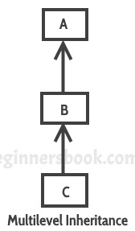
Access Specifier / Modifier
In this diagram,
class C inherits class B and
class B inherits class A which means
B is a parent class of C and
A is a parent class of B.
So in this case class C is implicitly inheriting the properties and methods of class A along with class B that's what is called
multilevel inheritance.

Slide 24
Example
class Length
{
int len = 100;
}
class Breadth extends Length
{
int bre=20;
}
class FsL6Inheritance extends Breadth
{
public static void main(String[] args)
{
FsL6Inheritance obj = new FsL6Inheritance();
obj.dispArea();
}
public void dispArea()
{
System.out.println("Area :" + len*bre);
}
}

Slide 25
Access Specifier / Modifier
/*
WAJP using four classes. Class containing
main function should using multi-level inheritance obtain
sec, min and hrs from the respective classes. Each class should
have its default constructor which should get called on creating
object of class containing main(). Each of the default constructor
should interact with the user as shown below.
enter seconds:
4
enter minutes:
5
enter hours:
6
In addition convert min to seconds and hours to seconds in the default constructor.
Class containing main function should also have dispTime() which
on calling should display hrs, min and sec in hh:mm:ss format:
06:05:04
and it should also display total seconds of above time
21908
*/

